Slide 1
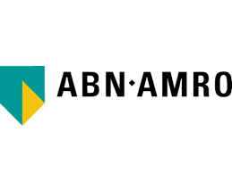
Credit Lending HLA
By Riya Sharma
14 March, 2025

Slide 2
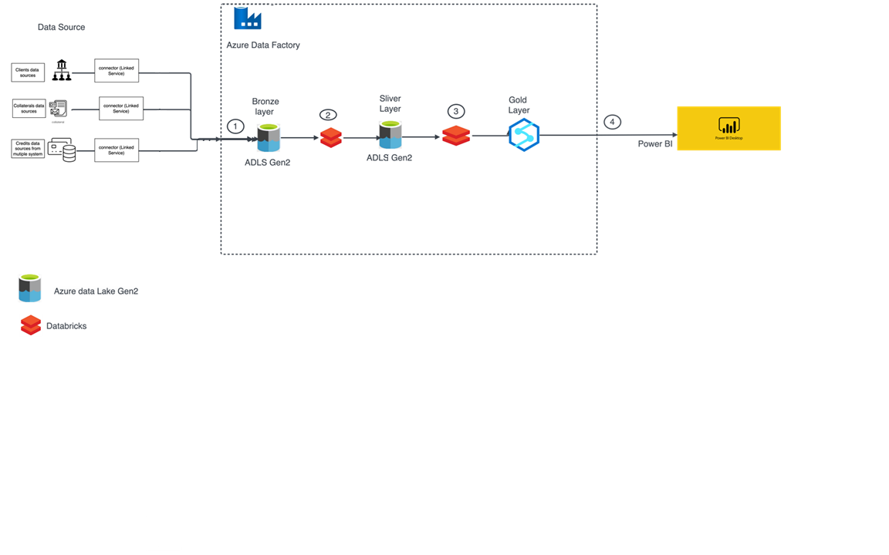
High Level Architecture

Slide 3
Tools Used
Ingestion:
Ingestion using Azure Data Lake Storage Gen2 (ADLS Gen2) to process structured or unstructured data from various sources into ADLS Gen2 for storage.
Processing:
Using Databrics to enable processing scalable and collaborative big data analytics using Apache Spark on Azure, facilitating ETL and real-time data processing.
Analytics :
Using Power BI to transforms data into actionable insights through interactive visualizations and reports.

Slide 4
ETL Process
Extraction:
Azure Data Factory: enables data integration from diverse sources using built-in connectors.
Transformation:
Databricks: Complex data workloads and transformation logic are powered by Apache Spark within Databricks.
Loading:
Data loading to various targets is automated by Azure Data Factory

Slide 5
Thank You

